Slide 1
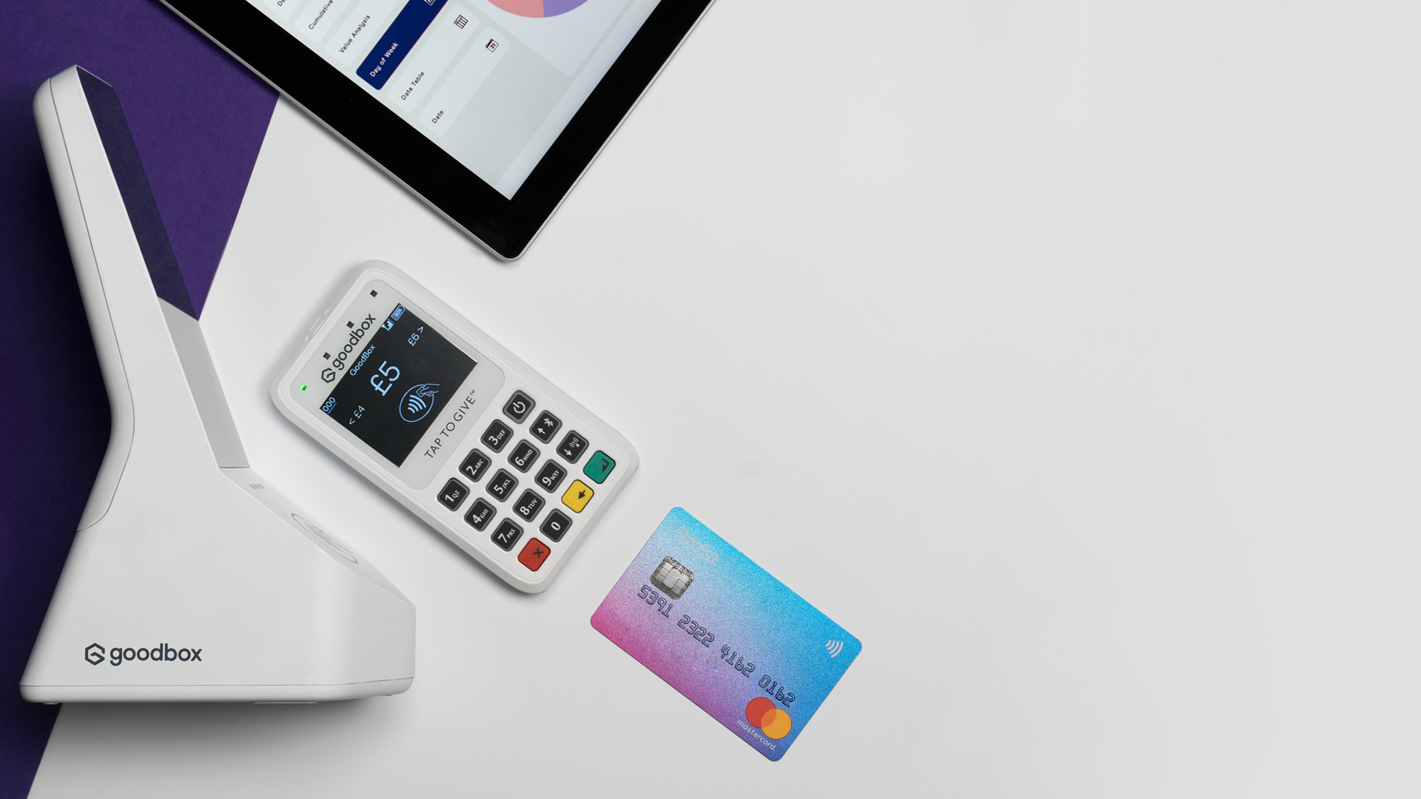
Pricing
2022

Slide 2
GoodBox
Pricing
A FEW KEY PRINCIPLES APPLY:
Our market-leading contactless hardware is available for lease and purchase, providing our charity partners with ultimate flexibility at a fair price.
A per transaction fee of 2.5% +10p applies to each donation
Access to our insightful data portal is included for all clients
Need extra support? Let us know. At GoodBox, our goal is your success.
GOODBOX – PRICING 2022
All listed prices are exclusive of VAT and delivery.

Slide 3
Why GoodBox?
SECURE & CERTIFIED
LIFETIME CONNECTIVITY
OFFLINE PAYMENTS
FOR FUNDRAISERS
As an FCA regulated payment company and a ICO registered data controller, you can rest assured that your donations will reach your account safely and securely. We are PCI and GDPR compliant, meaning we have you covered when it comes to data security and regulation.
GoodBox devices use WiFi and carry their own SIM cards, enabling mobile connectivity and giving you the best chance of strong connectivity. Plus our units work independently of other slave devices – no frustrating apps or smart phones required.
All GoodBox devices accept donations with zero connectivity, meaning no more failed donations or awkward waits trying to process in crowded or low signal areas. GoodBox offline capability offers unrestricted fundraising – anywhere, anytime.
Every product we bring to market is created with charities in mind, but our technology is only the first step. Through working in close partnership with our charity clients, we ensure that fundraisers get the value they deserve from our products.
GOODBOX – PRICING 2022
All listed prices are exclusive of VAT and delivery.

Slide 4
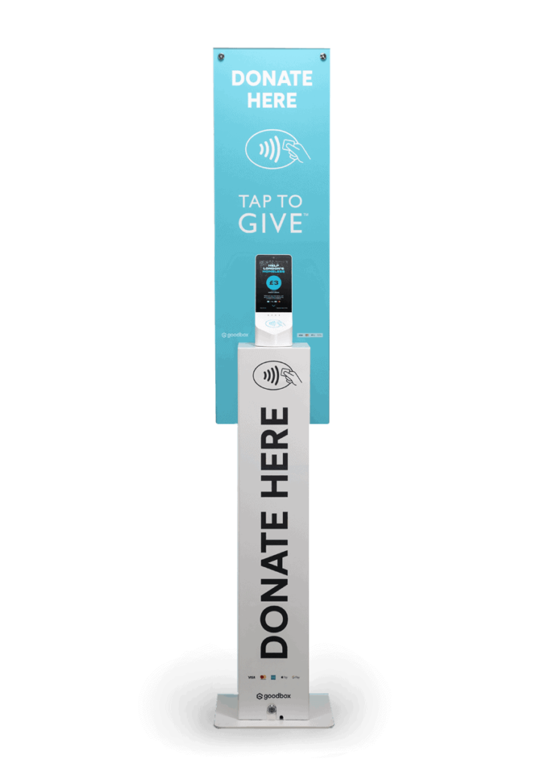
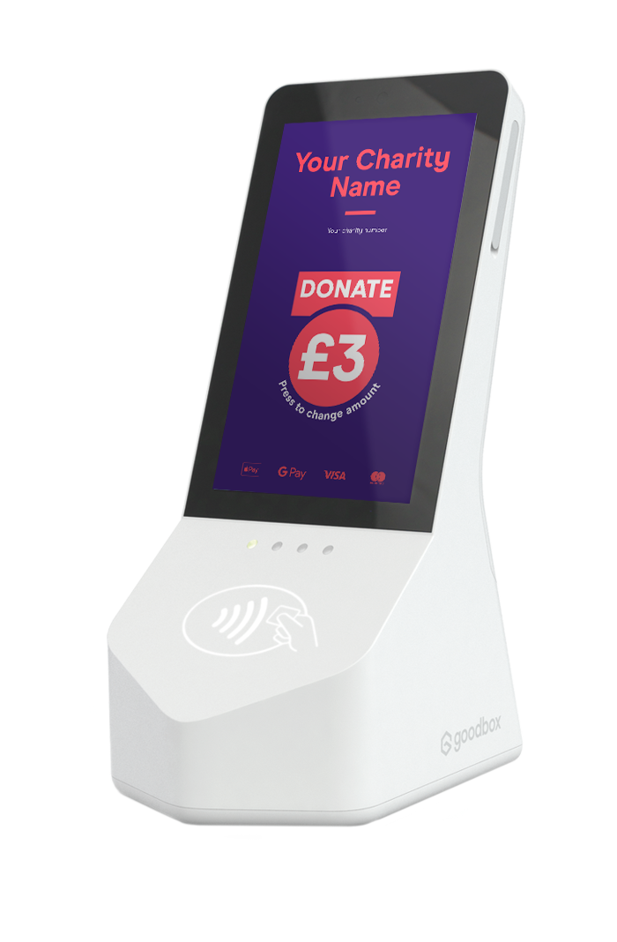
All listed prices are exclusive of VAT
GBx Core
GBx Podium
NOT FOUND A SUITABLE PACKAGE?
This is an overview of pricing for our key products. For bespoke orders and bulk discounts, reach out to a member of our team.
Ensure your fundraising has presence in larger spaces with the GBx Podium. Interchangeable and customisable graphics provide you with more space for messaging, and its size makes the Podium perfect for fundraising in large spaces. Costs are inclusive of the GBx Core and a security pack. GBx Core artwork priced separately.
Capture donors’ attention with the GBx Core’s full colour HD screen. Perfect for attended & unattended fundraising, the touchscreen allows donors to increase or decrease their chosen donation amount. The device has four hours battery life, or can be plugged in to mains for continuous usage.
Purchase
UNIT SPECS | UNIT PRICE | MONTHLY SERVICE FEE (12 month minimum)
Original (no cash box, no battery) | £950 | £17.50
With cash box | £1,205 | £17.50
With battery (28 hours) | £1,205 | £17.50
With cash box & battery | £1,455 | £17.50
sales@goodbox.com
Purchase
Screen Artwork
UNIT PRICE | MONTHLY SERVICE FEE (12 month minimum)
£375 | £17.50
PACKAGE | PRICE
Standard | £50
Advanced | £70
Bespoke | £150
Default | Free
ARTWORK GUIDES
Design packages are available through GoodBox, or you can design your own artwork supported by free DIY guides.
Lease
Panel Artwork
MONTHS | MONTHLY SERVICE FEE
6 | £60.00
12 | £50.00
24 | £35.00
36 | £30.00
TEMPLATES
TEMPLATES
PACKAGE | FEES
Standard | £75
Advanced | £90
Bespoke | £175
Default | Free
Design packages are available through GoodBox, with various templates available.
DIY GUIDE
Bespoke artwork is available upon request. Our inhouse design team will create it to your specification. Contact a member of the team for more information.
TEMPLATES
All listed prices are exclusive of VAT and delivery.

Slide 5
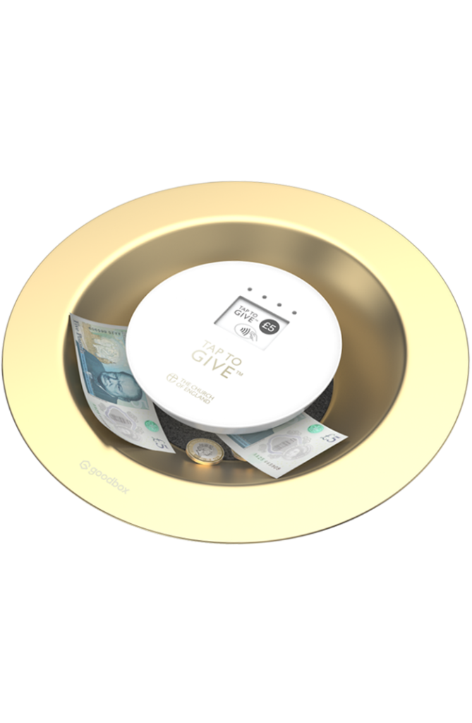
GBx Mini
GoodPlate
HAVE QUESTIONS?
Seamlessly accept Chip & Pin and contactless donations. A hand-held device, the GBx Mini is compact and versatile with up to three hours battery life, and additional removable batteries available.
Collect donations with our twist on the traditional church collection plate. Perfect for church fundraising, the GoodPlate is a custom-built plate which can collect coins, notes and Gift Aid slips whilst also collecting contactless through the GBx Mini device at its centre.
Email sales@goodbox.com to speak to our friendly team.
Purchase
Purchase
All listed prices are exclusive of VAT and delivery.
UNIT PRICE | MONTHLY SERVICE FEE (12 month minimum)
£125 | £17.50
UNIT PRICE | MONTHLY SERVICE FEE (12 month minimum)
£215 inc Mini | £17.50
£90 exc Mini | -
Lease
MONTHS | MONTHLY FEE
6 | £30.00
12 | £25.00
24 | £20.00
36 | £17.50

Slide 6
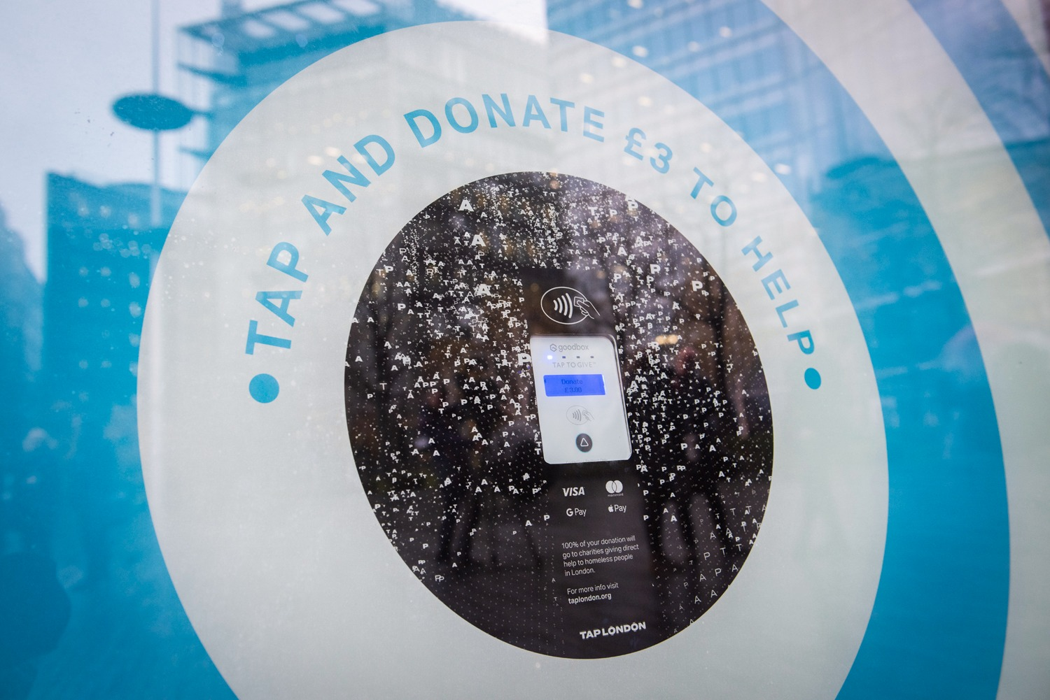
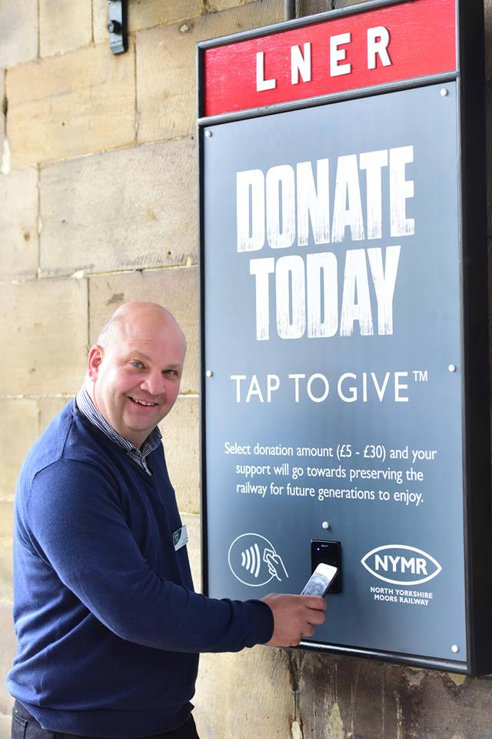
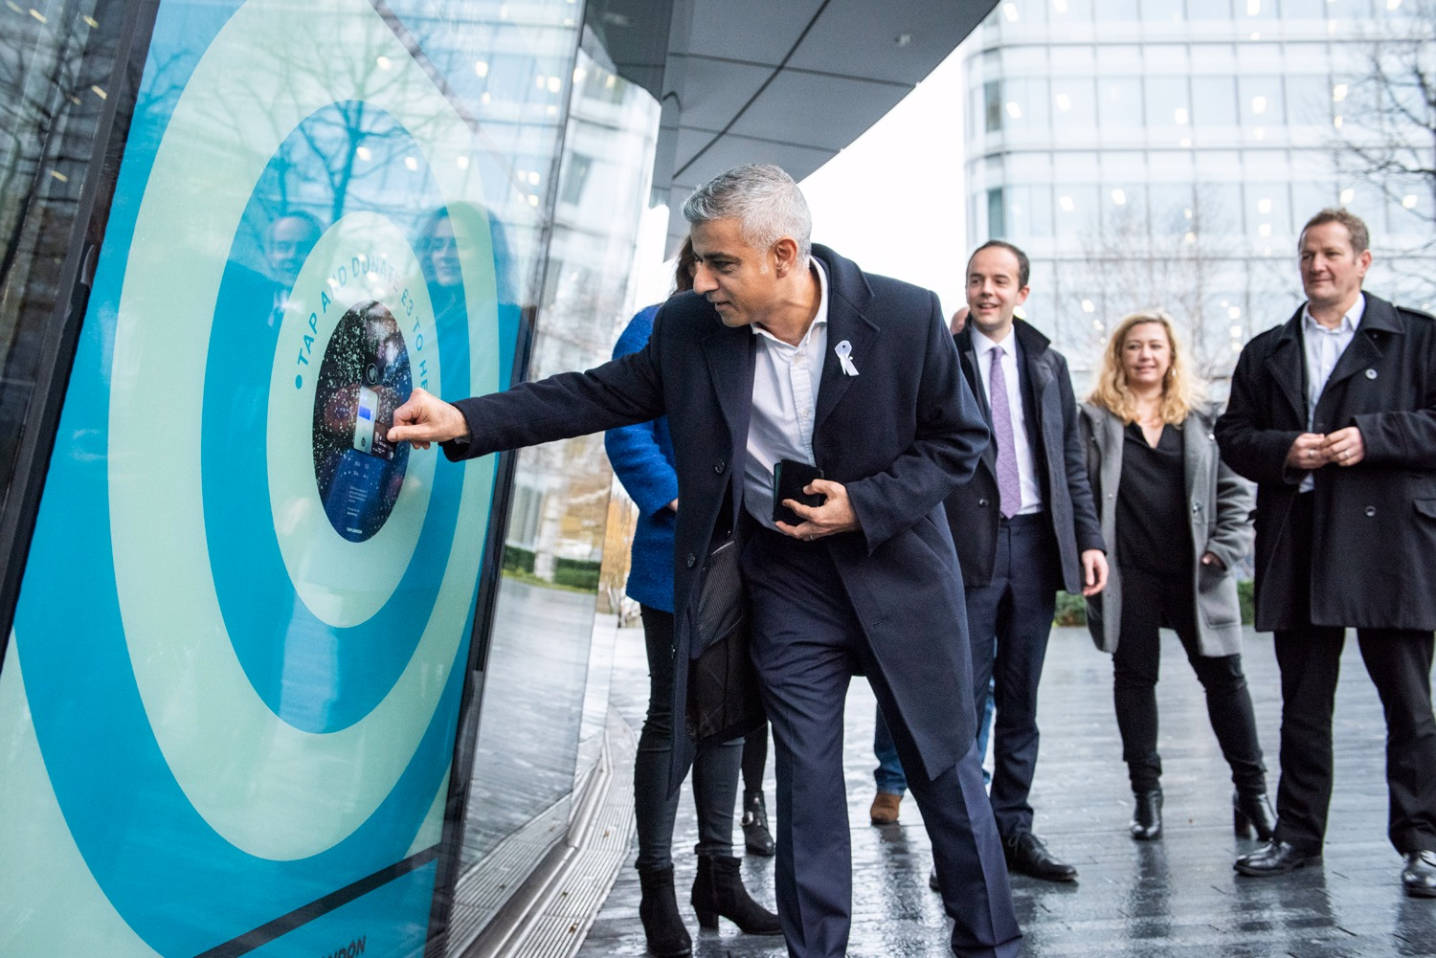
GBx Integrated
HAVE QUESTIONS?
Collect donations in any environment with our most adaptable contactless device. The GBx Integrated can accept donations behind glass, and is easily installed into a variety of custom donation points thanks to its light weight and size.
Simple ‘tap and go’ contactless technology
Configurable donation amounts up to £100
Donations processed via mobile signal – no Wi-Fi needed
Donations stored offline when connection is unstable
Plugs into mains for continuous power
Email sales@goodbox.com to speak to our friendly team.
All listed prices are exclusive of VAT and delivery.
Lease
MONTHS | MONTHLY FEES
6 | £60.00
12 | £50.00
24 | £35.00
36 | £30.00
Purchase
UNIT COST | MONTHLY SERVICE FEES
£350.00 | £17.50
Accessories
ITEM | COST
Window mount | £30.00
SPECIFICATIONS

Slide 7
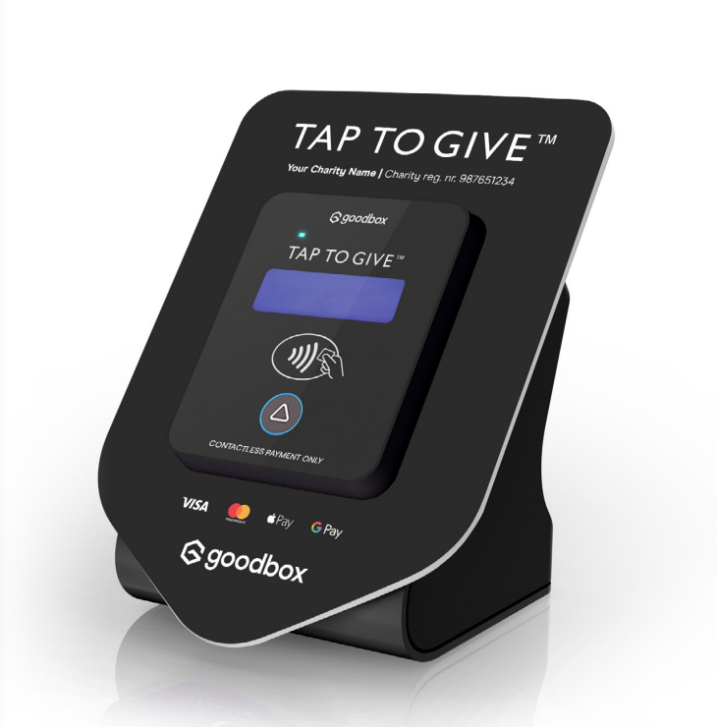
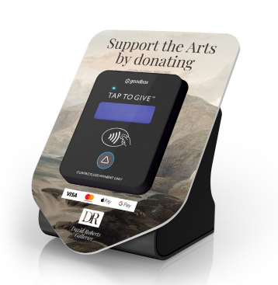
All listed prices are exclusive of VAT
GBx Countertop
ARTWORK SHIELDS
Want to brand your Countertop to a specific campaign or cause? Design packages are available through GoodBox at the prices listed below.
Perfect for unattended fundraising, the GBx Countertop allows donors to increase or decrease their chosen donation amount to maximise your fundraising potential. The device is plugged into mains for continuous usage.
Simple ‘tap and go’ contactless technology
Configurable donation amounts up to £45
Button allows donors to select their chosen donation
Donations processed via mobile signal – no Wi-Fi needed
Donations stored offline when connection is unstable
Plugs into mains for continuous power
PACKAGE | FEES
DIY | £15
Default | £15
Bespoke | £75
TEMPLATES
Lease
MONTHS | MONTHLY FEES
6 | £60.00
12 | £50.00
24 | £35.00
36 | £30.00
Purchase
UNIT COST | MONTHLY SERVICE FEES
£380.00* | £17.50
*Includes shield
Accessories
ITEM | COST
Shield | £30.00
sales@goodbox.com
All listed prices are exclusive of VAT and delivery.

Slide 8
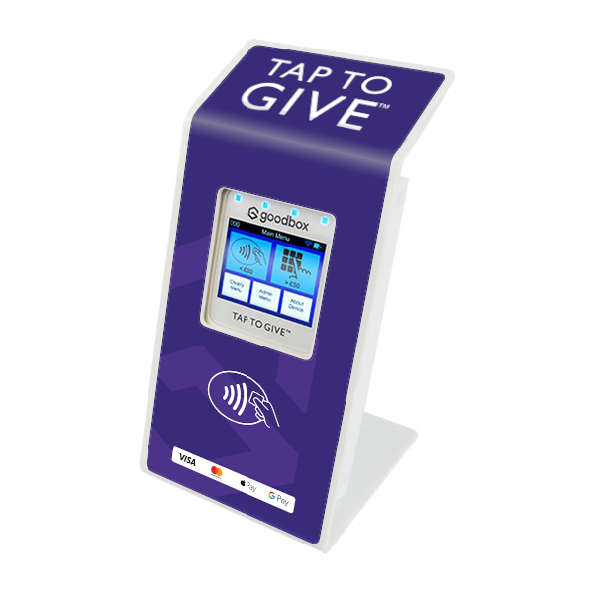
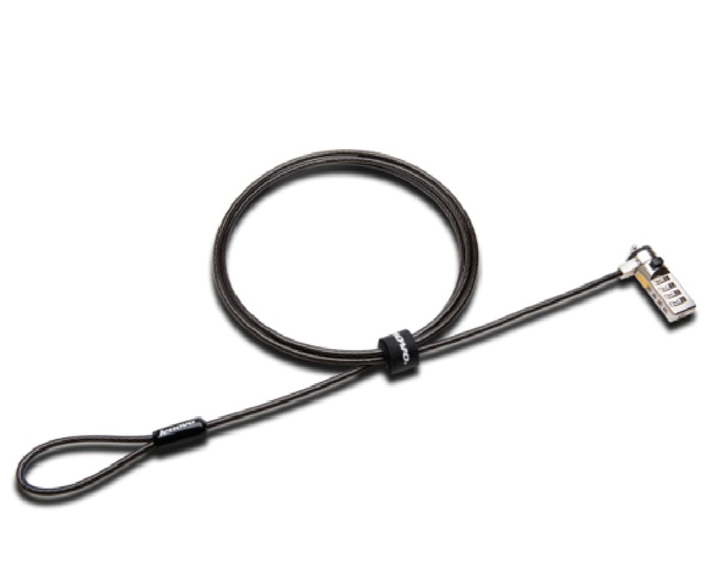
Fee-free fundraising
Add-on
Accessories
Remove transaction fees for the first £1,000 each month across all devices.
MONTHLY COST
£20
We build modular accessories which ensure that our products are adaptable to every fundraising environment.
GBx Mini Additional Battery
Purchase
Purchase a removable battery for your GBx Mini, enabling you to quickly swap out batteries when you’re on the go, or on longer fundraising drives.
UNIT PRICE
£15
GBx Mini Stand
Purchase
The Stand features an ergonomic handle for manned contactless fundraising and can also be left unattended. Shipped with standard artwork (as shown in image).
Custom artwork available from £15 through a recommended supplier
UNIT PRICE
£30
sales@goodbox.com
Security Pack
Purchase
A looping Kensington lock which enables you to secure your device for stress-free fundraising. Suitable for use with GBx Core, GBx Podium, GBx Mini.
UNIT PRICE
£15
GOODBOX – PRICING 2022
All listed prices are exclusive of VAT and delivery.

Slide 9
Email
Meeting
sales@goodbox.com
BOOK NOW
GOODBOX.COM

Slide 10
All listed prices are exclusive of VAT
GBx Integrated Podium
PODIUM ARTWORK
The GBx Integrated Podium is a free-standing unit, which – with the GBx Integrated at its centre – enables effortless contactless fundraising in museums and large public spaces.
Customisable Graphics provide you with further space to share your charity’s message
Accepts most major payment methods incl. Apple Pay, Google Pay, VISA & MasterCard
Optional Cash-box to accept cash & contactless donations
Optional battery provides 28-hours battery life or plug into mains for continuous fundraising
Want to brand your Podium to a specific campaign or cause? Design packages are available through GoodBox at the prices listed below.
PACKAGE | FEES
DIY | Free
Default | Free
Standard | £75
Advanced | £90
Bespoke | £175
TEMPLATES
Purchase
UNIT SPECS​ | UNIT PRICE​ | MONTHLY SERVICE FEE​ (12 month minimum)​
Original ​ (no cash box, no battery)​ | £950​ | £17.50​
With cash box​ | £1,205 | £17.50​
All listed prices are exclusive of VAT and delivery.
*Podium shown with default artwork applied
sales@goodbox.com

Slide 11
Christmas
OFFER
Save up to
£180
Add the GBx Core to your fundraising arsenal from just £25 for 36 months.
The award-winning device has a built in HD screen with customisable messaging and artwork to display your mission and thank donors. The intuitive design allows users to choose their donation amount and is suitable for use even when unattended.
£900
Total
Offer available until 31.12.21 Cannot be combined with other offers.

Slide 12
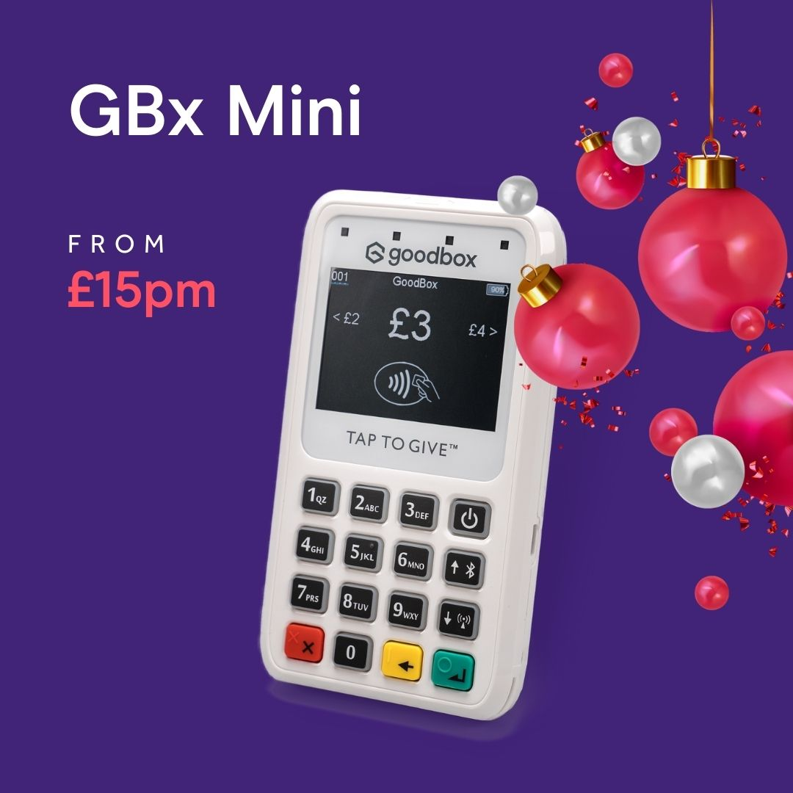
Christmas
OFFER
Save up to
£215
Lease the GBx Mini from just £15 per month for 36 months.
The versatile device accepts offline donations as well as chip and donations, making potential donations limitless. The GBx Mini is great for events and manned fundraising of all kinds.
£540
£200
Offer available until 31.12.21 Cannot be combined with other offers
Total

